Slide 1
Optimal Path Planning of an Exploratory Rover
ENAE681 – Final Project
8 DEC 2023

Slide 2
Topic Overview
Project introduction
Methodology and derivation
Optimization Algorithms
Optimal Paths
Intermediate Optimizer Steps
Conclusions
Goal: can we develop a STL-based routine to automatically detect anomalous maritime behavior?

Slide 3

Problem Statement
Suppose a planetary rover is driving over an arbitrary terrain and has some timed requirement – what’s the shortest timed path between two points?
Applications
Goal: can we develop a STL-based routine to automatically detect anomalous maritime behavior?
Search and rescue
Transportation problems
Exploration
Military/warfare maneuvering
Vehicle/environment parameters based on Mars Opportunity Rover

Slide 4
Problem Formulation
Suppose a planetary rover is driving over an arbitrary terrain and has some timed requirement – what’s the shortest timed path between two points?
Assumptions:
Goal: can we develop a STL-based routine to automatically detect anomalous maritime behavior?
4-wheeled, rigid rover
Simple vehicle dynamics with 1-torque operation setting
Traversing mars
Sharp maneuvers are allowable (relative to the global path)
Vehicle/environment parameters based on Mars Opportunity Rover

Slide 5
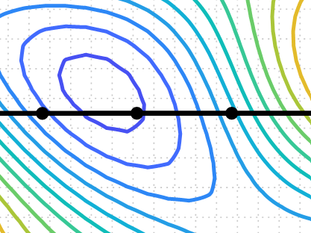
Problem Formulation
Design point, N_{i}, with allowable movement
Contour Height [m]

Slide 6
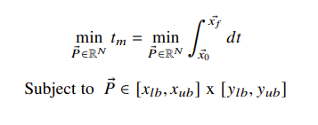
Problem Formulation
Design point, N_{i}, with allowable movement
Contour Height [m]

Slide 7
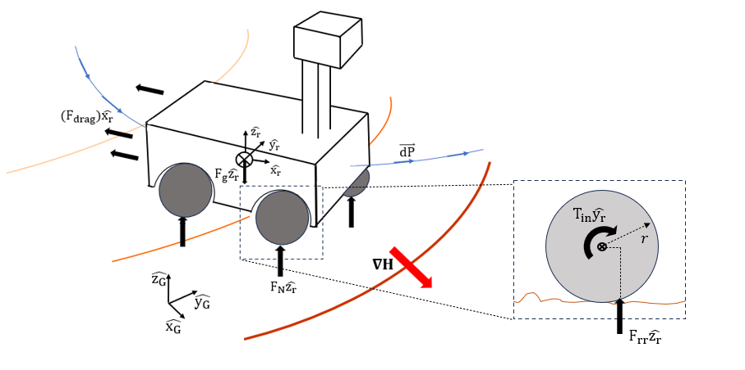
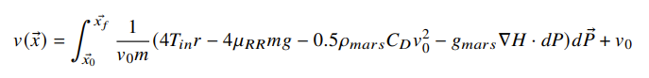
Methodology
Goal: can we develop a STL-based routine to automatically detect anomalous maritime behavior?
Aerodynamic drag
Gravity
Ground reaction
Input torque
Rolling resistance

Slide 8
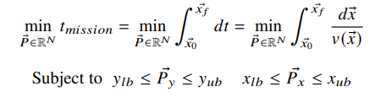
Methodology
Goal: can we develop a STL-based routine to automatically detect anomalous maritime behavior?
Aerodynamic drag
Gravity
Ground reaction
Input torque
Rolling resistance

Slide 9
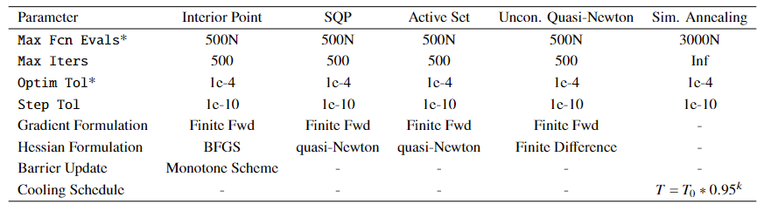
Optimization Algorithms
Wide range of algorithms selected for potential different formulations of the vehicle/terrain modelling.
Objective is smooth and constraints unlikely to be active!

Slide 10
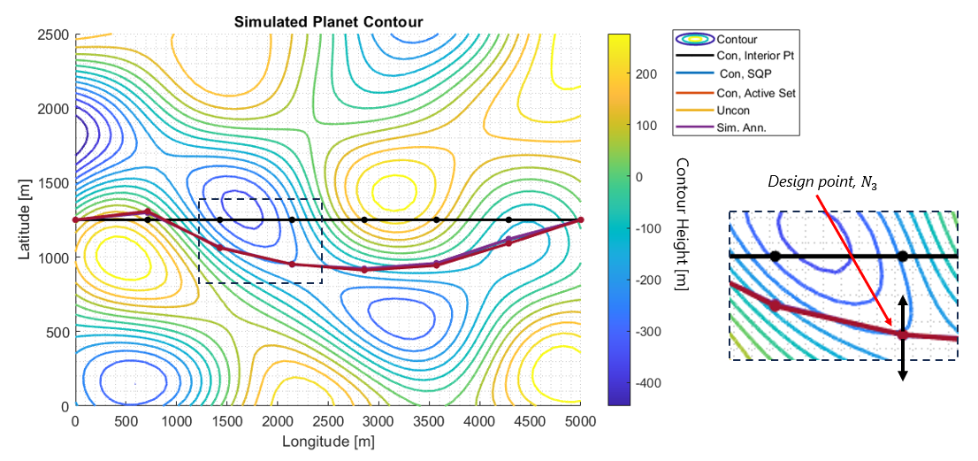
Results
Minimization shows a 21 sec improvement over the straight-line time
Initial optimization with N = 6 design variables and v0 = 10 m/s.

Slide 11
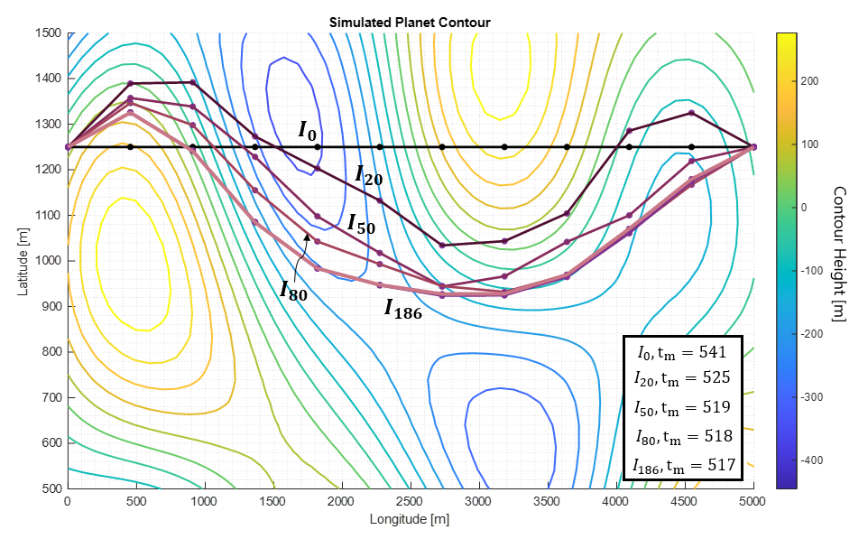
Results
Intermediate steps show the physical path the optimizer takes as it arrives at the global optimum.
The optimal path avoids large gradients and tends to traverse along the normal when required.
Unconstrained optimization with N = 10 design variables and v0 = 10 m/s.

Slide 12
Conclusions
All methods successfully found the optimum with a 23-24 sec improvement over a straight path.
For the smooth objective with no active constraints, a quasi-Newton unconstrained algorithm was best suited
Constrained methods similarly solved the problem and would find applicability when areas of the terrain must be avoided
Gradient free methods found the optimum well and would be required for complex vehicle dynamics and an uneven terrain
Adding constraints or complex dynamics come at a sharp computational cost (2-5x cost of the unconstrained).

Slide 13
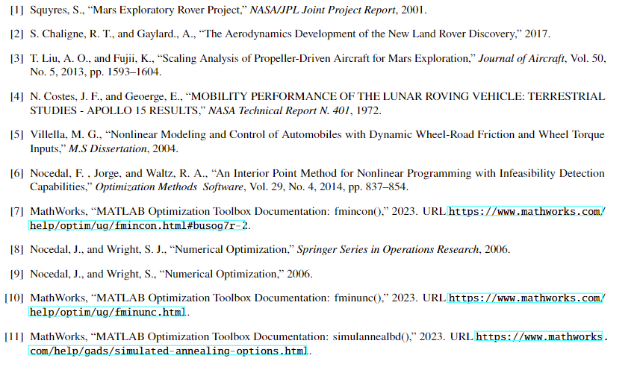
Works Cited

